Slide 1


YUCI
C Poorvika - 22PD10
Data Science Intern, Yubi

Slide 2
Academic Guide
Director
Dr.R Nadarajan
Department of Applied Mathematics and Computational Sciences
PSG College of Technology
Dr. Poomagal S Associate Professor
Department of Applied Mathematics and Computational Sciences
PSG College of Technology
Special thanks
Head of the Department
Dr.Shina Sheen
Department of Applied Mathematics and Computational Sciences
PSG College of Technology
Tutor
Ms. Lakshmi Kalpana Roy K Assistant Professor
Department of Applied Mathematics and Computational Sciences
PSG College of Technology
Programme Coordinator
Dr.Senthil Kumar M
Department of Applied Mathematics and Computational Sciences
PSG College of Technology
Industry Mentor
Mr. Nishanth Ronald Director - CAPL Data Science Department
Yubi Fintech Group

Slide 3


Overview
Introduction to the Organization
Solution
Timeline
Problem statement
Tools &
Technologies used
Q & A

Slide 4
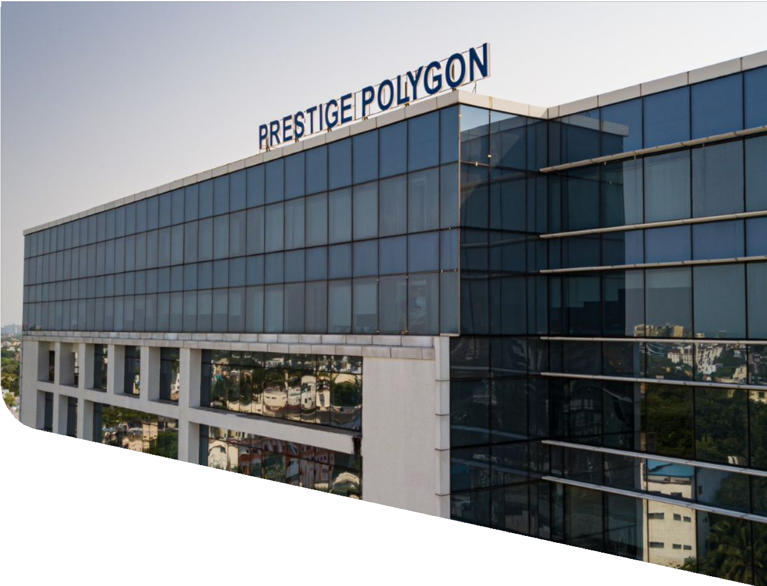

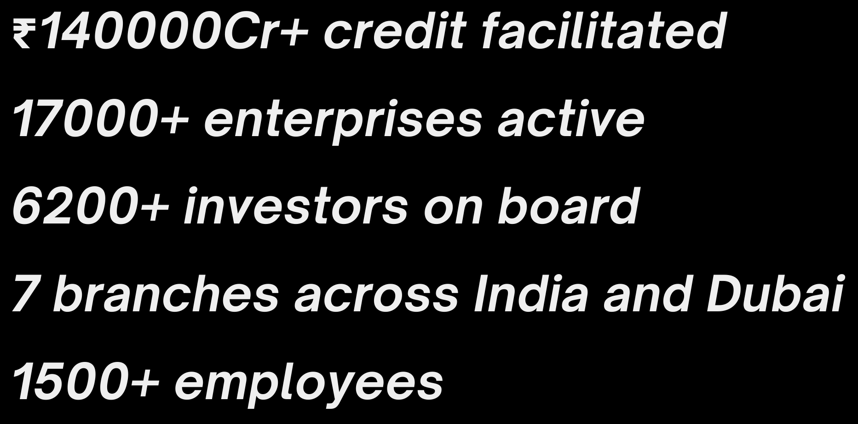
Yubi
About Yubi
Yubi (formerly CredAvenue) is a global fintech unicorn revolutionizing corporate debt markets by connecting borrowers, lenders, and investors on a unified digital marketplace. Founded in 2020, it powers the entire debt lifecycle—covering loans, co-lending, securitization, bonds, and supply chain financing—while serving 80% of India’s top banks and 150+ NBFCs. With AI-driven solutions like YuSight (credit assessment), YuCi (conversational intelligence), and YuAccess (document due diligence), backed by the Yubi Security Assurance (YSA) framework, Yubi ensures efficient, secure, and accessible debt financing.

Slide 5
Hardware Specifications Processor - Apple M1 Pro Installed Memory - 16GB
System Type - 64-bit Operating System, ARM64-based processor
Work environment
Software Specifications
macOS Sequoia 15.6.1

Slide 6
YUCI
YuCI being a part of the YuVerse products is a cutting-edge Conversational Intelligence (CI) tool that evaluates call quality with precision. Its advanced ASR module listens to voice interactions and seamlessly transcribes them into text mainly concentrating on Indian regional languages, significantly enhancing compliance monitoring efficiency and ensuring smoother, more compliant customer interactions.

Slide 7
Automatic Speech Recognition - ASR To convert spoken language (audio) into written text using various models (Benchmarking).
Voice of the Customer The sentiment analysis project evaluated public perception of the Bank and its competitors using data collected from platforms such as Reddit, Trustpilot and Google Play Store.
Financial Statement Analyser Developed an AI-powered ETL pipeline that automated extraction of financial data and transformed unstructured text into structured JSON formats using LLMs.
Problem Statements

Slide 8
Solution

Slide 9
Automatic Speech Recognition
Converting audio files and performing automatic speech recognition (ASR).
It is the technology that converts spoken language (audio) into written text.
1. Converts audio files (MP3 to WAV) and processes audio channels (stereo to mono) to prepare input data in the ideal format for ASR models, improving transcription accuracy and efficiency.
2. Resamples all audio to 16 kHz, the standard sample rate required by many ASR models, ensuring compatibility and better recognition performance.
3. Used the AI4Bharat Indic-Conformer 600M multilingual model, optimized for Indian languages, combined with advanced decoding methods like CTC and RNNT, resulting in accurate speech-to-text transcriptions in multiple languages.
4. Experimented with NVIDIA and other models such as FastConformer, Canary, and Whisper, demonstrating flexibility in choosing architectures based on accuracy or speed requirements.

Slide 10
Sentiment Analysis
Data extracted from multiple Social media platform is aggregated and transformed to know about the people’s view on the bank
Reviews
Text Extraction
Sentiment analysis
Data
Unstructured
Comments
Tweets
For Sentiment Analysis:
VADER
RoBERTa-Twitter model
RoBERTa-Base
TextBlob
Bert classification model

Slide 11
Financial Statement Analyzer
Designed to extract structured financial data (Balance Sheet, Profit & Loss, Trading accounts, and Notes) from raw financial documents using a Large Language Model (LLM). The extracted data is saved into a clean JSON file for further analysis.
Specialized in prompt engineering to ensure accurate, consistent outputs and robust handling of edge cases.
Conducted result validation and iterative prompt fine-tuning to optimize accuracy and reliability.
Key Components
1. LLM Setup:
Defines an LLM class to connect with a language model API (like GPT, Claude, Gemini, etc.).
Handles sending prompts and receiving responses in text format.
2. Prompt Engineering
Built a very detailed prompt that tells the LLM exactly how to extract financial data.
3. JSON Parsing
The script uses JsonOutputParser and regex helpers to ensure the LLM’s output is valid JSON.

Slide 13
Ongoing - ASR
Within the YUCI team, we are focused on optimizing transcription costs while maintaining high accuracy. Currently, the company relies on AWS Transcribe, which incurs a cost of ₹1.75 per minute—a price point that clients are unwilling to accept. To address this, we are evaluating alternative models that balance cost efficiency and accuracy.
Key Components
1. Model Validation
Executed the AI4Bharat model on audio files across three different languages.
Generated and manually validated transcriptions in a non-diarized form.
2. Accuracy Benchmarking
Used AWS transcripts as ground truth and calculated WER and CER (via jiwer) for AI4Bharat outputs.
Compared transcripts from AI4Bharat, AWS, Azure, GPT-4o, and Gemini, evaluating them on WER, CER, and SER to identify the most accurate model.

Slide 14
Ongoing - ASR
3. Segmentation Approach
Instead of using full audio files, segmented audio into 30-second clips.
Built ground truth transcripts manually for these segments, ensuring higher granularity.
4. Metric Analysis
Defined and prepared metric ground truths in JSON format.
Extracted metrics outputs from AI4Bharat and Gemini transcripts using LLMs.
Performed semantic matching between ground truth and model-generated metrics using both:
LLM-based evaluation
Heuristic matching with Sentence Transformers
To enable deep, granular insights into call content beyond raw transcription.

Slide 16








Tools & Technologies
Programming
Extraction
PDF Parsing libraries for unscanned pdfs - pdfplumber
VLMs and OCR tools for Scanned PDFs
JSON formatter
LLM

Slide 17

Timeline
June
July - Week 1
July - Week 2 & 3
July - Week 4 & Aug - Week 2
Onboarding and KT sessions
Experimenting and benchmarking different tools for ASR transcription
Working on the First Task Splitting into teams for information collecting, cleaning and analysis for a bigger client project
Intern Hackathon (ETL pipeline)
Team allocation and starting works on deliverables.

Slide 18
Q & A

Slide 19
THANK YOU

